Slide 1
Lenus (web-application)
Course: cse-499b
Faculty: dr. shohana Rahman deeba
Team name: area 51

Slide 2
Lenus (Web-application)
Team Members
Name: | Rahat Islam Akash
Id: | 1631239042
Name: | Md. Nafiz Pervez
Id: | 1612482042

Slide 3
Acknowledgment
It is imperative to show our application for our honorable faculty member Dr. shohana Rahman Deeba for her undivided attention and help to achieve this milestone. Also, our gratefulness is divine to the North South University, ECE department for providing us a course such as CSE 499 in which we could really work on this project and materialize it the way we dreamt of.

Slide 4
Introduction
LENUS is a web-application which can be helpful during any pandemic situation as like novel coronavirus. Considering the present scenario, we all can see that the pandemic is spearheading in much faster speed than before. The number of patient and patient related issues are increasing day by day. Cost of the treatments are also increasing, now even for a normal medical consultation you have to pay a good amount of money. Considering all of these circumstances and based on the COVID patient and non-COVID patient, we developed a web application CRM system. Now this CRM stands for Customer Relation Management, where in LENUS we successfully implement this relation platform between a customer such as patient and a doctor, with free of cost. Patient of any kind of disease including covid disease they can meet their expected consultation through this web application. Focusing this part of the app we all illustrated so many feathers which settles the CRM system more workable and realistic. Views can even see the scenario of current pandemic of anywhere of the country including Bangladesh and also get to have some fun with some entertainment and news feature with in this one single platform “LENUS”.

Slide 5
Targeted users
Considering all of these circumstances our targeted users are COVID patient and non-COVID patient. Based on our targeted users we have create our web-application in CRM(customer relation management) system.

Slide 6
Our services
Doctor call and appointment
Ambulance service
Volunteer service
Fire Service
Police service
Physiotherapist appointment and call
Online medicine shop
Live corona virus update
Pandemic care
Video call service
Blood Donation service

Slide 7
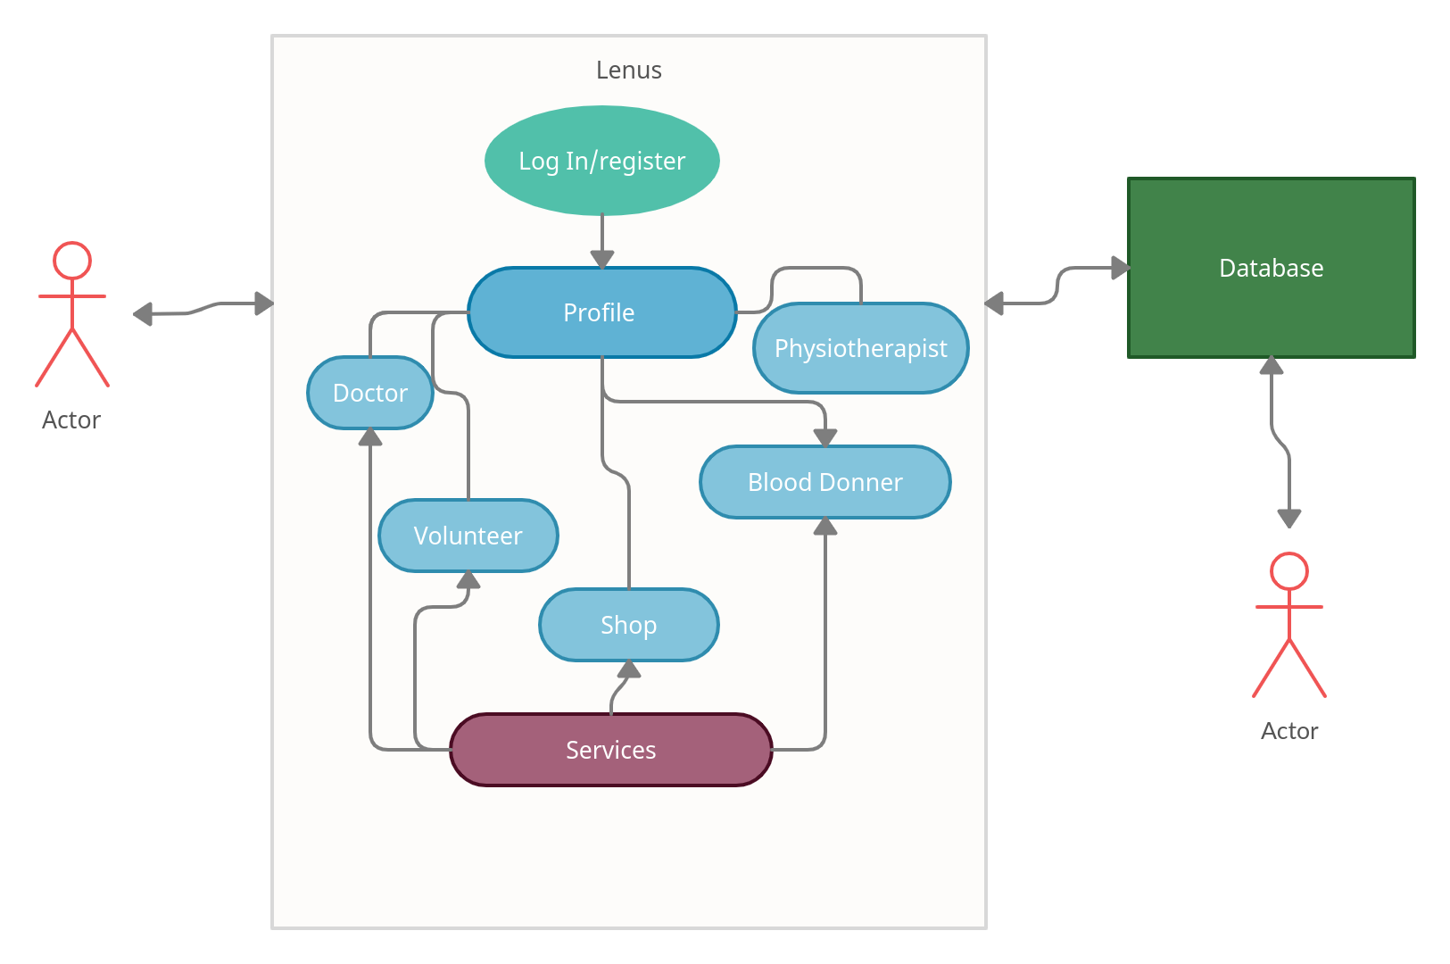
Basic use-case diagram

Slide 8
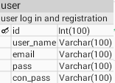
Data base diagram
User Table: User table of the data base used for the new user registration in our system.

Slide 9
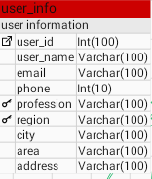
Data base diagram
User-info Table: user info table of our data base contain all the important information related to the individual users.

Slide 10
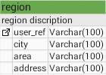
Data base diagram
Region Table: we create region table to identify the individual user according to their location.

Slide 11
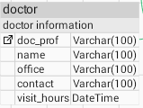
Data base diagram
Doctor Table: doctor table in our data base contain the necessary information of a doctor according to their region.

Slide 12
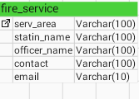
Data base diagram
Fire-service Table: this table contain the necessary information related to the fire-service.

Slide 13

Data base diagram
Police Table: this table of our data base contain the main information of the police according to their region.

Slide 14
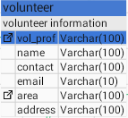
Data base diagram
Volunteer Table: volunteer table of our data base contain the volunteer information.

Slide 15
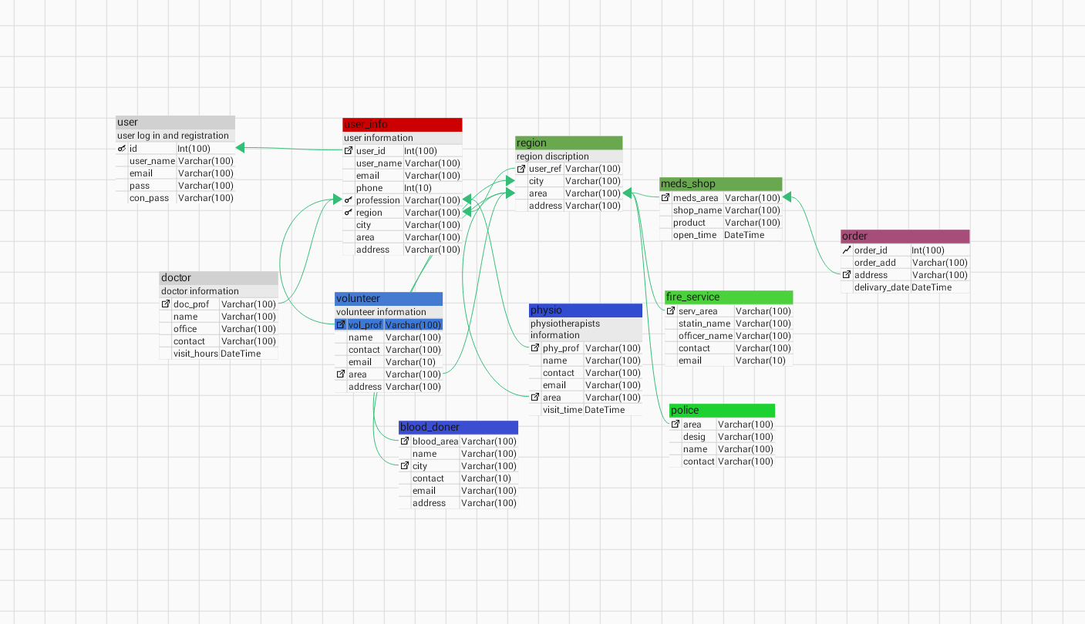
Data base relation

Slide 16
Project demonstration

Slide 17
Thank you

